Slide 1
Network Methods for NLP
Noah Amsel
11/6/18

Slide 2
Introduction

Slide 3
Why Network Methods in NLP?
Graphs are a natural way of representing relationships between words, sentences, and documents
Strong mathematical theory — lots of well-studied algorithms
Clustering / community detection, mincuts
Random Walks
Spectral methods
Centrality (for ranking)
Neural nets on graphs
Long history of use for core NLP tasks like word-sense disambiguation, summarization, topic modeling, and sentiment analysis
Drago’s slides from week 1 have good background on some of these methods
Notes:
We’ll be seeing applications of all these methods and several of these tasks in the next hour
Graphs are a natural way of representing relationships between words, sentences, and documents
Strong mathematical theory — lots of well-studied algorithms
Clustering / community detection, mincuts
Random Walks
Spectral methods
Centrality (for ranking)
Neural nets on graphs
Long history of use for core NLP tasks like word-sense disambiguation, summarization, topic modeling, and sentiment analysis
Drago’s slides from week 1 have good background on some of these methods

Slide 4
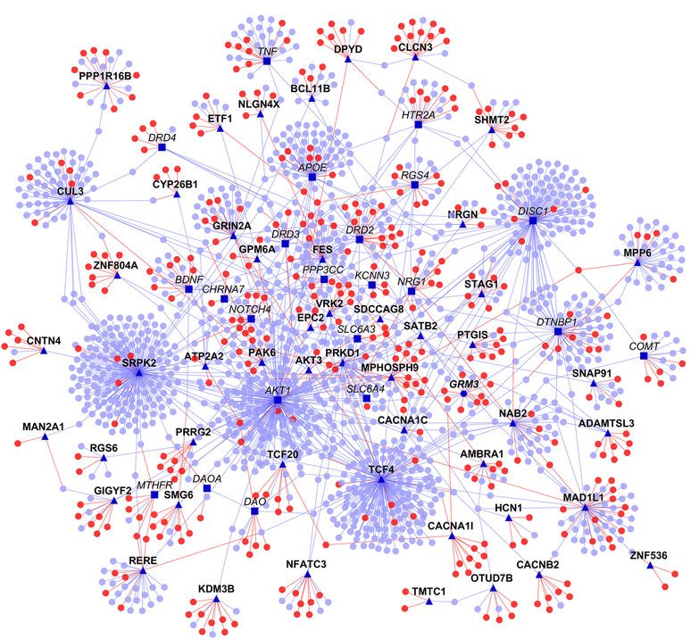
Graphs can model relationships in different domains
Biological networks
https://www.ncbi.nlm.nih.gov/pmc/articles/PMC4898894/

Slide 5
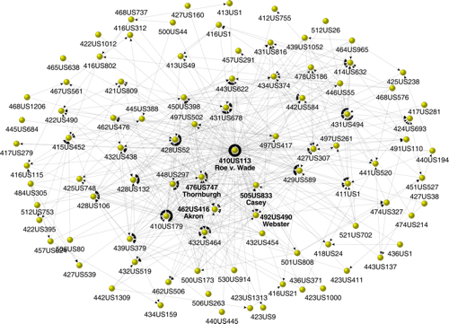
Graphs can model relationships in different domains
Information Networks (citation)
http://fowler.ucsd.edu/judicial.htm
Notes:
Shows supreme court case citations surrounding roe v wade

Slide 6
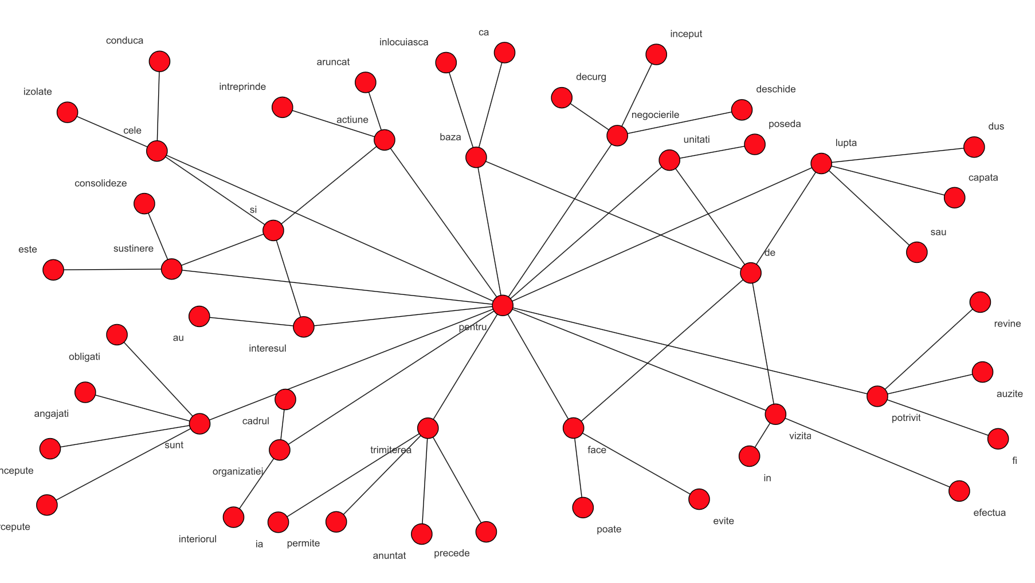
Graphs can model relationships in different domains
Language Networks!
http://tangra.cs.yale.edu/~radev/si/tut06/tut.pdf
Notes:
This is syntactic graph of pentru (“for”)
In Romanian. Words point to their head words in dependency parses

Slide 7
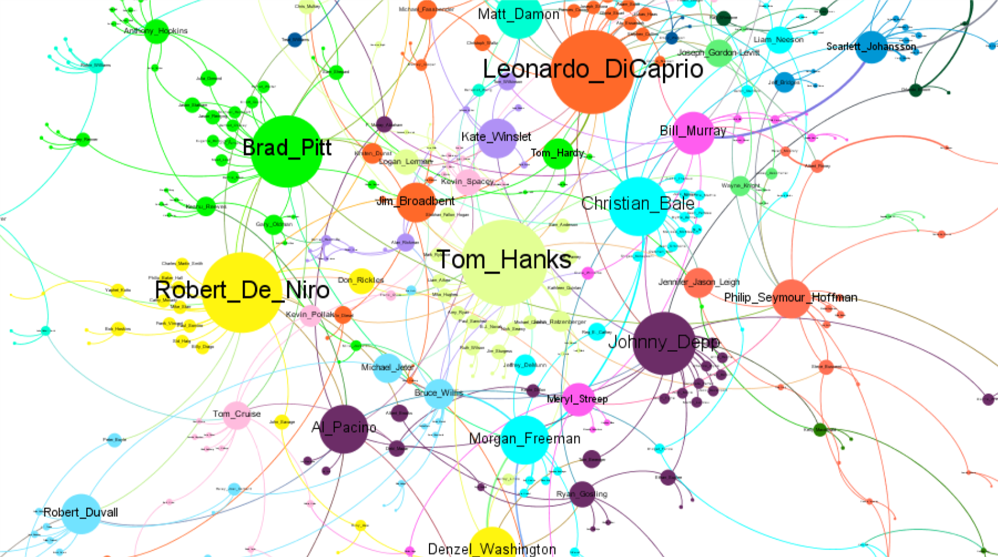
Graphs can model relationships in different domains
Collaboration Networks
https://katie-truong.github.io/network-analysis/IMDB/
Notes:
Six degrees of Kevin Bacon
There’s also a famous collaboration network in math: Erdos numbers

Slide 8
These networks are unrelated but have surprising properties in common
Many real world networks do not act like random graphs

Slide 9
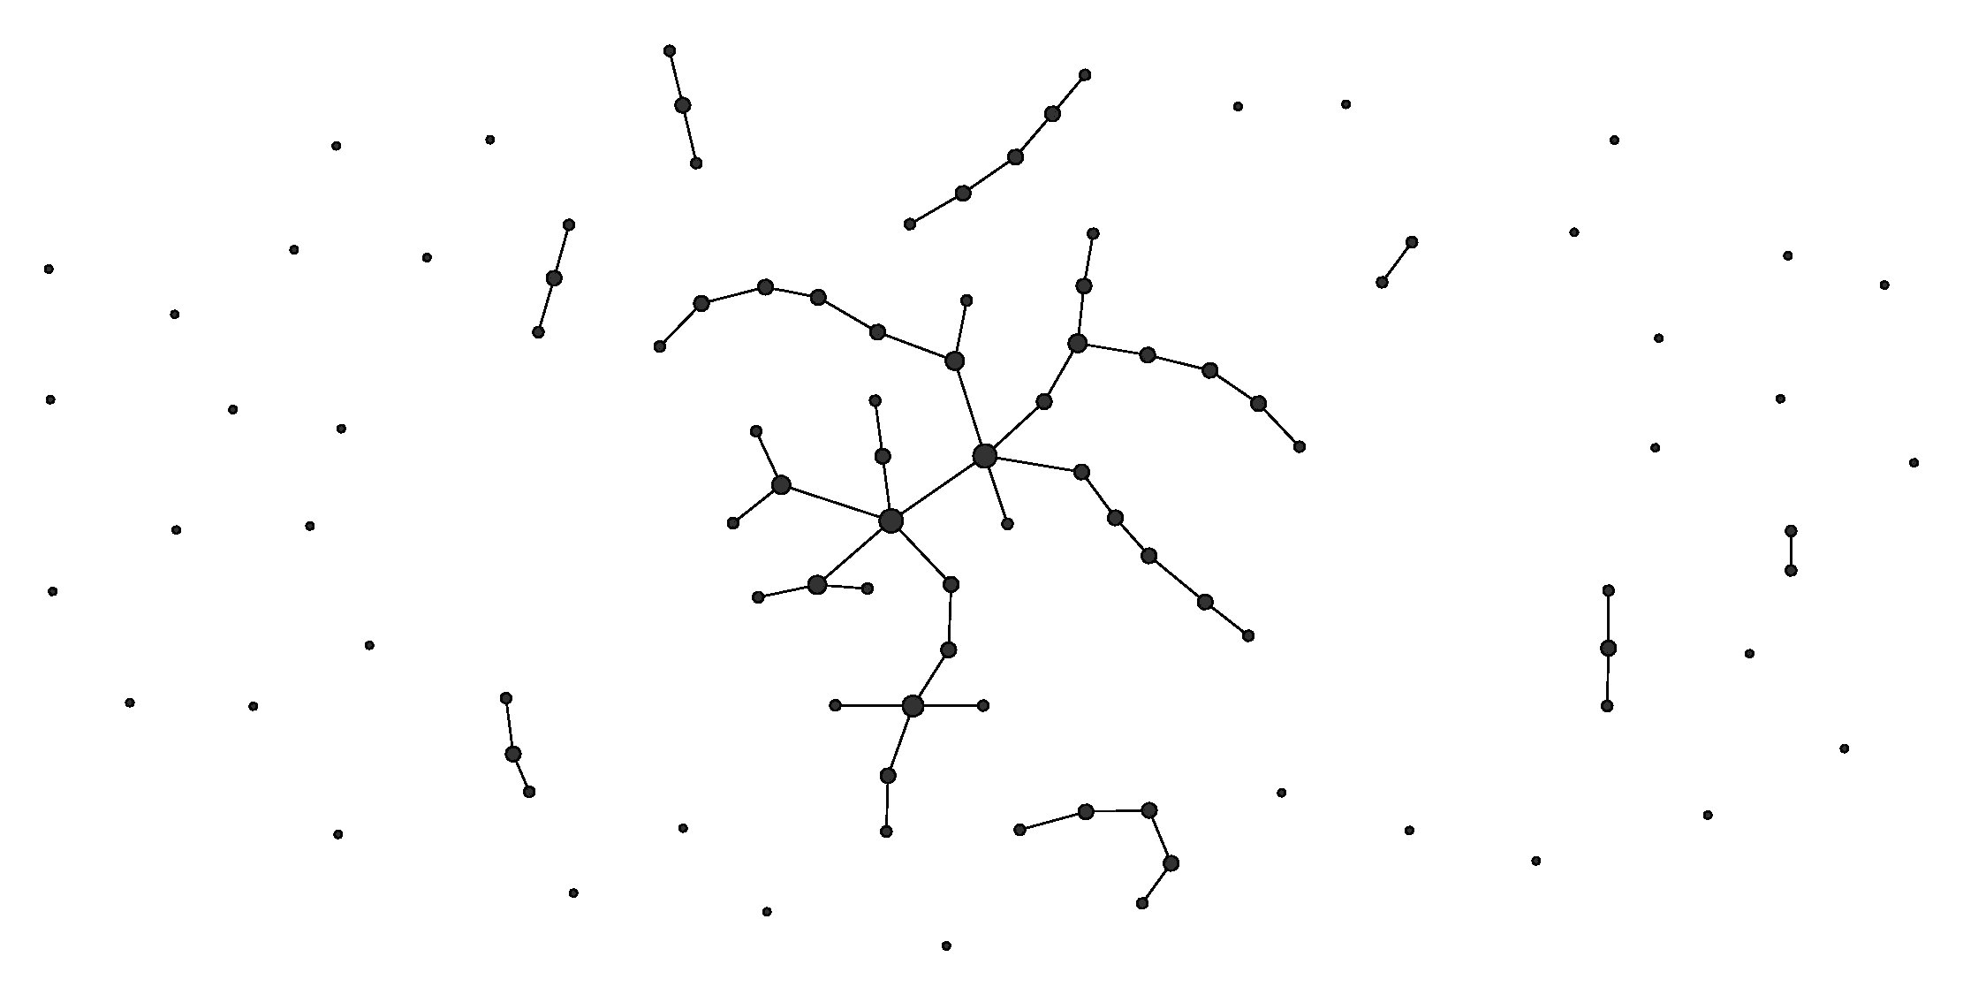
Random Graph (Erdos-Renyi)
Given n nodes, independently draw each of the possible (n choose 2) edges with probability p
https://upload.wikimedia.org/wikipedia/commons/1/13/Erdos_generated_network-p0.01.jpg
Notes:
Now I’d like to walk thru a few interesting properties that distinguish the real world graphs we see from random graph
Given n nodes, independently draw each of the possible (n choose 2) edges with probability p

Slide 10
Properties of Networks — Distance
Distance between vertices is length of shortest path between them
Milgram’s “small world effect”: how many times does someone in Omaha have to forward a letter to reach a total stranger in Boston?
“Six degrees of separation”
Average distance between pairs of nodes characterizes “small worlded-ness”
Extremely low in real networks (Choudhury):
Film actors 3.48
Company Directors 4.60
Emails 4.95
Internet 3.33
Electronic circuits 4.34
Notes:
Now I’d like to walk thru a few interesting properties that distinguish the real world graphs we see from random graph
Distance between vertices is length of shortest path between them
Milgram’s “small world effect”: how many times does someone in Omaha have to forward a letter to reach a total stranger in Boston?
“Six degrees of separation”
Average distance between pairs of nodes characterizes “small worlded-ness”
Extremely low in real networks (Choudhury):
Film actors 3.48
Company Directors 4.60
Emails 4.95
Internet 3.33
Electronic circuits 4.34

Slide 11
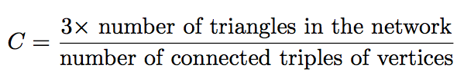
Properties of Networks — Clustering
Friendship is not transitive, but almost
If Joey knows Chandler, and Chandler knows Ross, likely that Joey knows Ross too
Likely that they form a triangle
Clustering coefficient is probability transitivity holds: fraction of triples that form a triangle
Notes:
Need the three because when there is a triangle, we count it as 3 connected triples (could center it on any of the tree)
Friendship is not transitive, but almost
If Joey knows Chandler, and Chandler knows Ross, likely that Joey knows Ross too
Likely that they form a triangle
Clustering coefficient is probability transitivity holds: fraction of triples that form a triangle

Slide 12
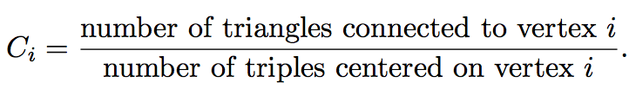
Properties of Networks — Clustering
“Local” clustering coefficient: probability that two of my friends are friends
Take average across all vertices to get an alternate definition of clustering coefficient
Notes:
“Local” clustering coefficient: probability that two of my friends are friends
Take average across all vertices to get an alternate definition of clustering coefficient

Slide 13
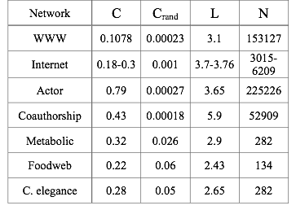
Properties of Networks — Clustering
In a random graph with n vertices and edge probability p:
average degree is 2(n choose 2) p / n ≈ np
Hold this constant as n grows, then p ≈ 1/n
So probability that two of my friends are friends is p ≈ 1/n
Clustering coefficients are way higher than expected in this model (Choudhury)
Notes:
Expected total # of edges is (n choose 2)p
Need a 2 because the number of degrees is twice the number of edges
Divide to get the avg
Left column C = actual clustering coefficient
Right column = expected for a random graph
It’s orders of magnitude more and this holds across different domains
In a random graph with n vertices and edge probability p:
average degree is 2(n choose 2) p / n ≈ np
Hold this constant as n grows, then p ≈ 1/n
So probability that two of my friends are friends is p ≈ 1/n
Clustering coefficients are way higher than expected in this model (Choudhury)

Slide 14
Properties of Networks — Degree Distribution
In Erdos-Renyi model: degree at any node is binomial
Holding np constant, this becomes Poisson as n → ∞
Very few nodes of high degree
Real networks have much fatter tails
Many nodes of high degree
“Scale-free networks”: degree distribution follows power law
(Like word distributions in Zipf’s Law!)
Notes:
Hold np constant b/c np = avg degree
In Erdos-Renyi model: degree at any node is binomial
Holding np constant, this becomes Poisson as n → ∞
Very few nodes of high degree
Real networks have much fatter tails
Many nodes of high degree
“Scale-free networks”: degree distribution follows power law
(Like word distributions in Zipf’s Law!)

Slide 15
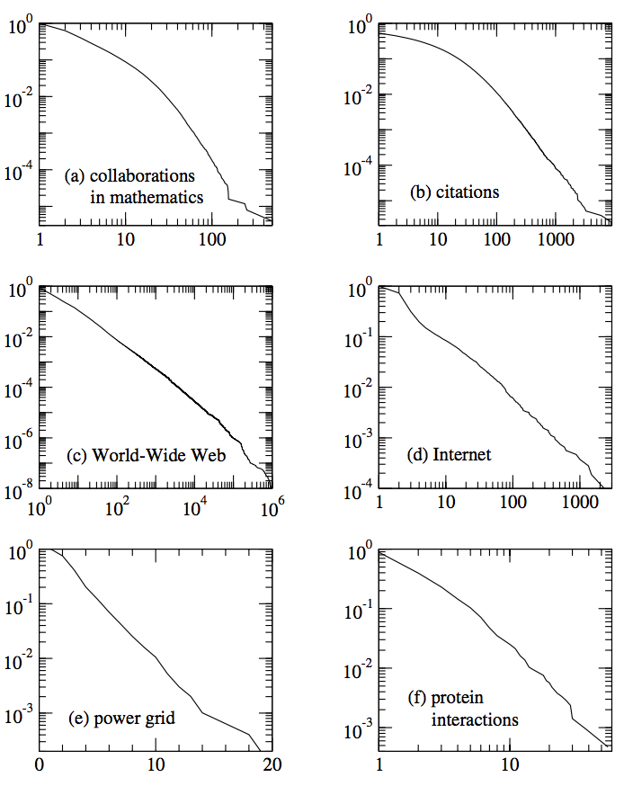
Properties of Networks — Degree Distribution
If degree distribution follows a power law, take the log of both sides and you’ll get a straight line!
This holds for diverse real-world networks
Notes:
EXCEPT (e), which has exponential distribution (shown on lin-log plot)
If degree distribution follows a power law, take the log of both sides and you’ll get a straight line!
This holds for diverse real-world networks

Slide 16
Where does the power law come from?
Barabasi-Albert model points to preferential attachment
Start with a partly-formed graph on m₀ vertices
Add nodes one-by-one
With each node add m new edges
Probability we add an edge to an existing node v is proportional to degree of v
“The rich get richer” = “The Matthew Effect”
https://en.wikipedia.org/wiki/Barab%C3%A1si%E2%80%93Albert_model#/media/File:Barabasi_Albert_model.gif
Notes:
EXCEPT (e), which has exponential distribution (shown on lin-log plot)
You can think of this effect as “” or “” which comes from
“unto every one that hath shall be given...but from him that hath not shall be taken away”
Barabasi-Albert model points to preferential attachment
Start with a partly-formed graph on m₀ vertices
Add nodes one-by-one
With each node add m new edges
Probability we add an edge to an existing node v is proportional to degree of v
“The rich get richer” = “The Matthew Effect”

Slide 17
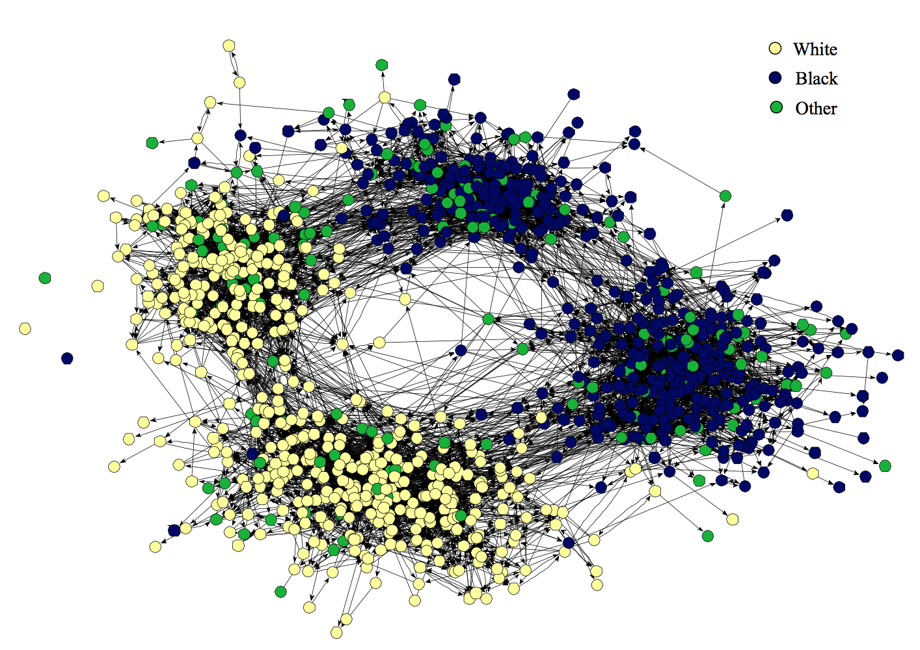
Properties of Networks — Communities
High edge density within communities
Low edge density between communities
Example: communities in a school reflect age and race divisions
https://epubs.siam.org/doi/pdf/10.1137/S003614450342480
Notes:
High edge density within communities
Low edge density between communities
Example: communities in a school reflect age and race divisions

Slide 18
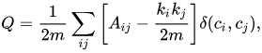
Properties of Networks — Communities
Lots of ways of detecting and quantifying communities
Given an assignment of vectors to communities, modularity is the number of edges within the communities above what’s expected randomly
Pick communities that maximize Q — well it’s NP-Hard
Many approximation algorithms: Louvain method, Chinese Whispers
Notes:
Formula: A_ij is adjacency
K_i is degree of vertex i
Delta is 1 if they’re in the same cluster
Lots of ways of detecting and quantifying communities
Given an assignment of vectors to communities, modularity is the number of edges within the communities above what’s expected randomly
Pick communities that maximize Q — well it’s NP-Hard
Many approximation algorithms: Louvain method, Chinese Whispers

Slide 19
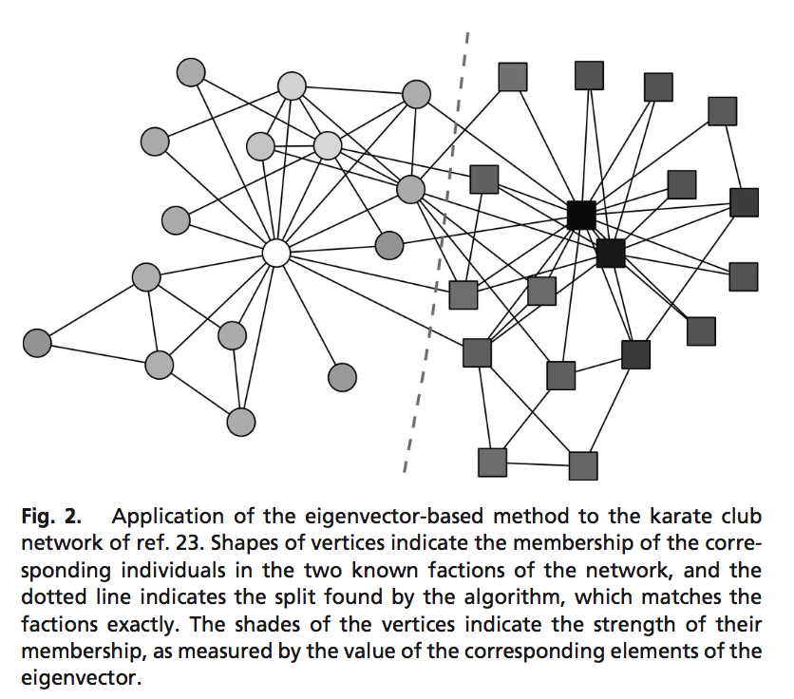
More demonstrations of community detection
“Zachary’s College Karate Club”
Good test case because the club actually split in two after data was collected
Newman’s eigenvector-based method recovered the split and scored each node’s importance to community
https://epubs.siam.org/doi/pdf/10.1137/S003614450342480
Notes:
“Zachary’s College Karate Club”
Good test case because the club actually split in two after data was collected
Newman’s eigenvector-based method recovered the split and scored each node’s importance to community

Slide 20
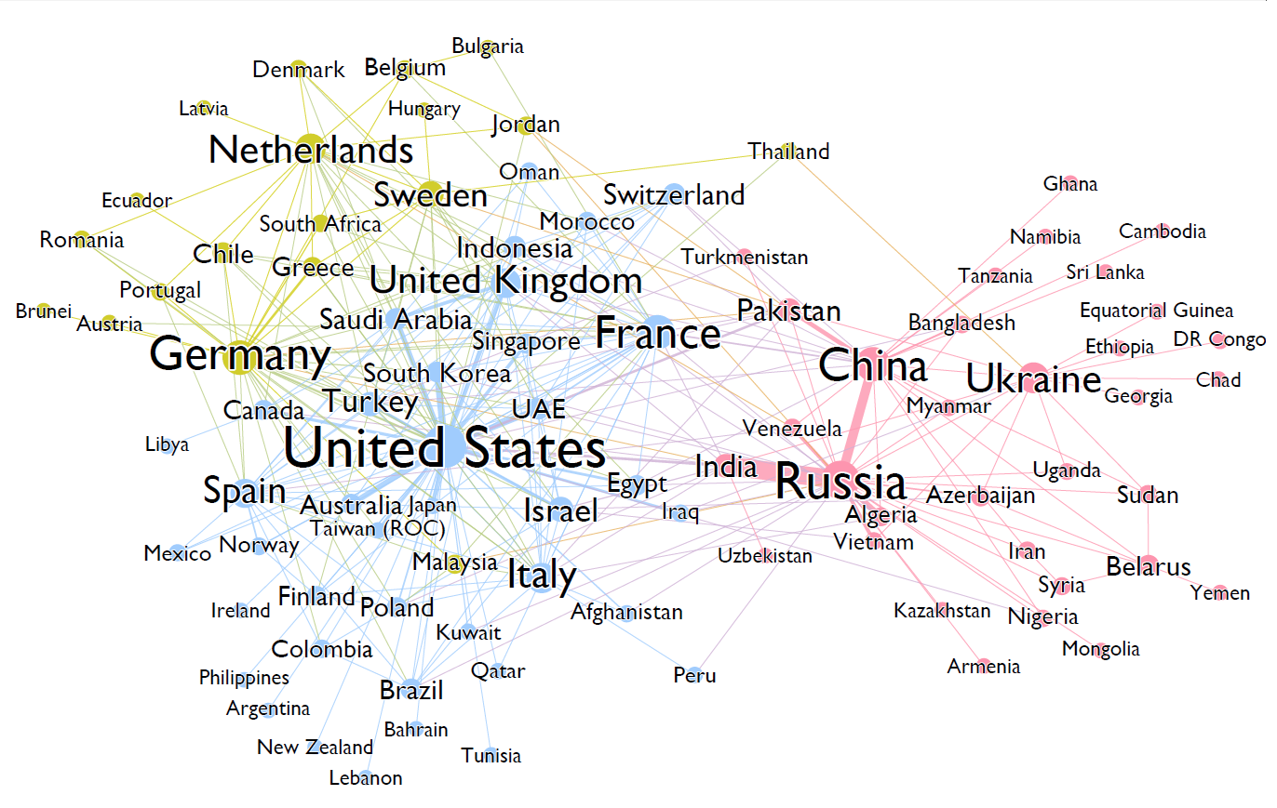
More demonstrations of community detection
Military alliances by arms sales
Used Louvain Method
Node size is PageRank Centrality
https://algobeans.com/2016/04/12/network-graphs-where-will-your-country-stand-in-world-war-iii/
Notes:
This is just a tutorial on network analysis, not a serious prediction :)
Military alliances by arms sales
Used Louvain Method
Node size is PageRank Centrality

Slide 21
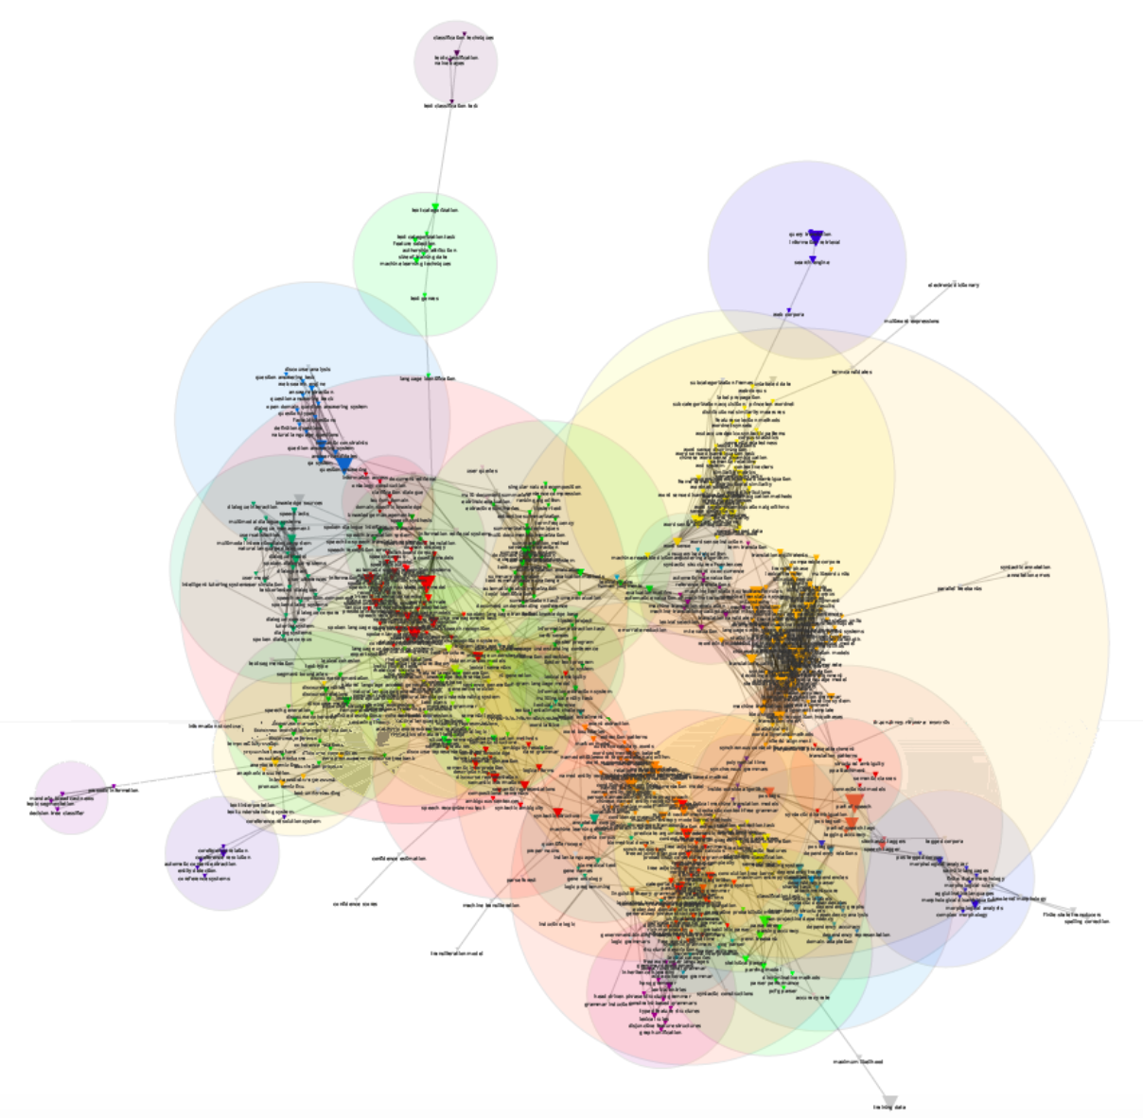
Community Detection to Study Growth of NLP
Omodei, Cointet, & Poibeau, 2014
http://www.lrec-conf.org/proceedings/lrec2014/pdf/643_Paper.pdf
Notes:
Skip this

Slide 22
Community Detection to Study Growth of NLP
Omodei et al study papers in the ACL Anthology from 1985-2008
“Mapping the Natural Language Processing Domain: Experiments Using the ACL Anthology” LREC 2014
Extract keywords from each title and abstract using standard methods (and human validation) — 673 in total
Build a graph with each keyword is a node
Add an edge if terms co-occur (weighted by mutual information)
Remove edges below a threshold weight
Applied Infomap and Louvain community detection
Example cluster: “entity detection - coreference relation - Automatic Content Extraction - coreference resolution - coreference resolution system - coreference system”
Notes:
Louvain method: init each node in its own community. For each node, see change in modularity from joining it into a neighbor, pick the best one
Once you can’t get any more modularity gains, redraw the network with components as nodes, and repeat

Slide 23
Community Detection to Study Growth of NLP
To study change over time, split the corpus into 4 time periods
Cluster keywords in each time period separately
Connect clusters from different time periods if they’re highly related (if they contain many common keywords)
Can play with time-scale, clustering scale, etc.
Subfields (clusters) can split in two or die out
Some example trends they identified:
Machine translation grows steadily
Birth of Question answering in the 90s and split from document summarization
Early 2000s: speech translation & spoken dialogue systems merged into task oriented dialogues
Notes:
How is size of cluster measured? Num of papers in that cluster?

Slide 24
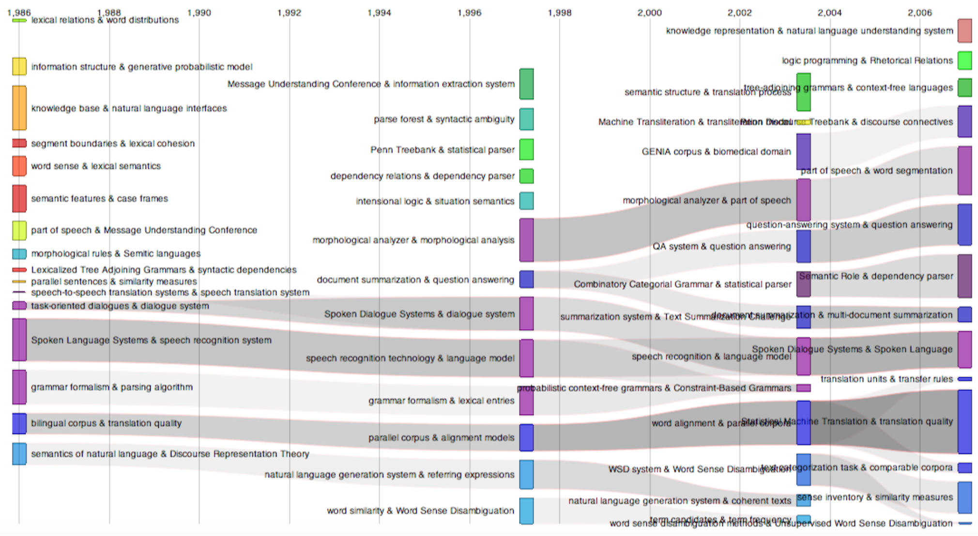
Community Detection to Study Growth of NLP
http://www.lrec-conf.org/proceedings/lrec2014/pdf/643_Paper.pdf
Notes:
How is size of cluster measured? Num of papers in that cluster?

Slide 25
“An Experimental Study of Graph Connectivity for Unsupervised Word Sense Disambiguation”
Roberto Navigli and Mirella Lapata
IEEE Transactions on Pattern Analysis and Machine Intelligence, 2010

Slide 26
Task: Word Sense Disambiguation
Set (v., trans):
to put (something or someone) in a particular place:to set a vase on a table.
to place in a particular position or posture:Set the baby on his feet.
to place in some relation to something or someone:We set a supervisor over the new workers.
to put into some condition:to set a house on fire.
to put or apply:to set fire to a house.
to put in the proper position:to set a chair back on its feet.
to put in the proper or desired order or condition for use:to set a trap.
to distribute or arrange china, silver, etc., for use on (a table):to set the table for dinner.
to place (the hair, especially when wet) on rollers, in clips, or the like, so that the hair will assume a particular style.
to put (a price or value) upon something:He set $7500 as the right amount for the car. The teacher sets a high value on neatness.
to fix the value of at a certain amount or rate; value:He set the car at $500. She sets neatness at a high value.
to post, station, or appoint for the purpose of performing some duty:to set spies on a person.
to determine or fix definitely:to set a time limit.
to resolve or decide upon:to set a wedding date.

Slide 27
Task: Word Sense Disambiguation
Set (v., trans.):
to cause to pass into a given state or condition:to set one's mind at rest; to set a prisoner free.
to direct or settle resolutely or wishfully:to set one's mind to a task.
to present as a model; place before others as a standard:to set a good example.
to establish for others to follow:to set a fast pace.
to prescribe or assign, as a task.
to adjust (a mechanism) so as to control its performance.
to adjust the hands of (a clock or watch) according to a certain standard:I always set my watch by the clock in the library.
to adjust (a timer, alarm of a clock, etc.) so as to sound when desired:He set the alarm for seven o'clock.
to fix or mount (a gem or the like) in a frame or setting.
to ornament or stud with gems or the like:a bracelet set with pearls.
to cause to sit; seat:to set a child in a highchair.
to put (a hen) on eggs to hatch them.
to place (eggs) under a hen or in an incubator for hatching.
to place or plant firmly:to set a flagpole in concrete.
to put into a fixed, rigid, or settled state, as the face, muscles, etc.

Slide 28
Task: Word Sense Disambiguation
Set (v., trans):
to fix at a given point or calibration:to set the dial on an oven; to set a micrometer.
to tighten (often followed by up):to set nuts well up.
to cause to take a particular direction:to set one's course to the south.
Surgery . to put (a broken or dislocated bone) back in position.
(of a hunting dog) to indicate the position of (game) by standing stiffly and pointing with the muzzle.
Music .
to fit, as words to music.
to arrange for musical performance.
to arrange (music) for certain voices or instruments.
Theater .
to arrange the scenery, properties, lights, etc., on (a stage) for an act or scene.
to prepare (a scene) for dramatic performance.
Nautical . to spread and secure (a sail) so as to catch the wind.
Printing .
to arrange (type) in the order required for printing.
to put together types corresponding to (copy); compose in type:to set an article.
Baking . to put aside (a substance to which yeast has been added) in order that it may rise.

Slide 29
Task: Word Sense Disambiguation
Set (v., trans.):
to change into curd:to set milk with rennet.
to cause (glue, mortar, or the like) to become fixed or hard.
to urge, goad, or encourage to attack:to set the hounds on a trespasser.
Bridge . to cause (the opposing partnership or their contract) to fall short:We set them two tricks at four spades. Only perfect defense could set four spades.
to affix or apply, as by stamping:The king set his seal to the decree.
to fix or engage (a fishhook) firmly into the jaws of a fish by pulling hard on the line once the fish has taken the bait.
to sharpen or put a keen edge on (a blade, knife, razor, etc.) by honing or grinding.
to fix the length, width, and shape of (yarn, fabric, etc.).
Carpentry . to sink (a nail head) with a nail set.
to bend or form to the proper shape, as a saw tooth or a spring.
to bend the teeth of (a saw) outward from the blade alternately on both sides in order to make a cut wider than the blade itself.
...

Slide 30
Task: Word Sense Disambiguation
“Unsupervised”
NO labeled data = corpus with labeled word senses
Expensive
Limited coverage
Doesn’t transfer to new domains
YES dictionary with predefined word senses
Like WordNet
Notes:
“Unsupervised”
NO labeled data = corpus with labeled word senses
Expensive
Limited coverage
Doesn’t transfer to new domains
YES dictionary with predefined word senses
Like WordNet

Slide 31
Unified Framework for Graph-based WSD
Build a lexical graph from the dictionary
Each node is a word-sense
For each ambiguous word, find the most “important”/“central” node
But how best to quantify “important”?
Notes:
More on each part in the next slides
Build a lexical graph from the dictionary
Each node is a word-sense
For each ambiguous word, find the most “important”/“central” node
But how best to quantify “important”?

Slide 32
Method — Constructing the Graph
Given a sentence with ambiguous words…
Remove non-content words (prepositions, pronouns...)
Initialize V (vertices) to contain all possible senses for words appearing in this sentence
For each sense v, search the neighborhood of v in WordNet for other senses in this sentence (distance ≤ L)
If you find one (v’), add the full path from v to v’ to our graph
Edges encode different relationships: “is-a”, “has-part”, “pertains to”, ...
Notes:
Search the neighborhood for other related senses… whether or not they’re related!
Given a sentence with ambiguous words…
Remove non-content words (prepositions, pronouns...)
Initialize V (vertices) to contain all possible senses for words appearing in this sentence
For each sense v, search the neighborhood of v in WordNet for other senses in this sentence (distance ≤ L)
If you find one (v’), add the full path from v to v’ to our graph
Edges encode different relationships: “is-a”, “has-part”, “pertains to”, ...

Slide 33
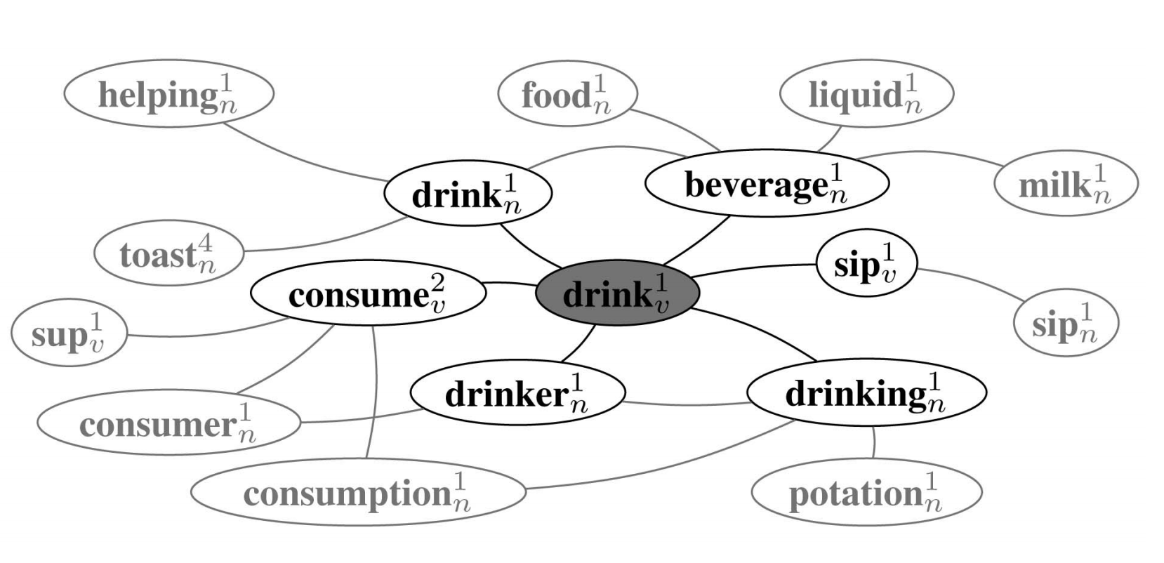
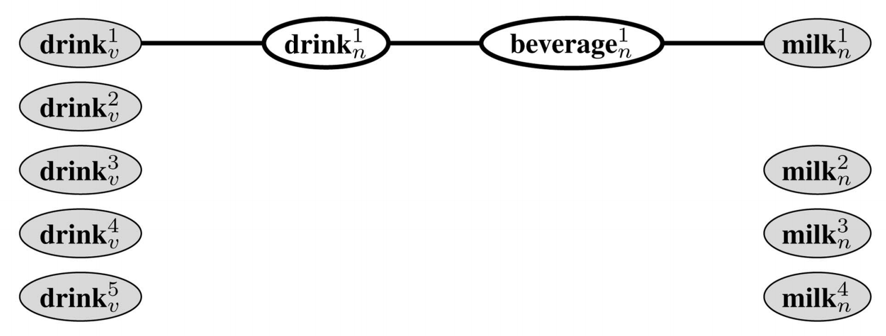
Method — Constructing the Graph
“She drank some milk”
“drink” (5 senses)
“milk” (4 senses)

Slide 34
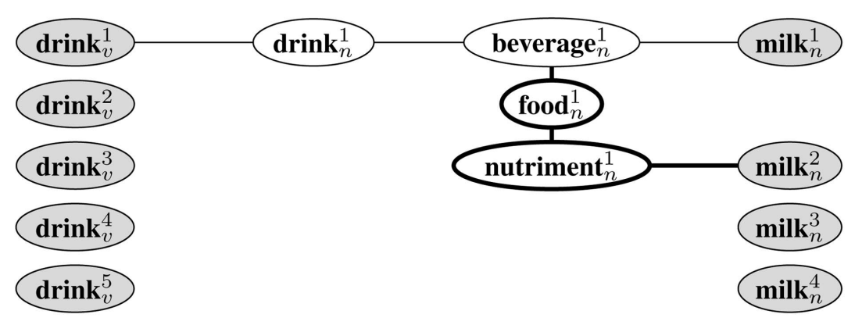
Method — Constructing the Graph
“She drank some milk”
“drink” (5 senses)
“milk” (4 senses)

Slide 35
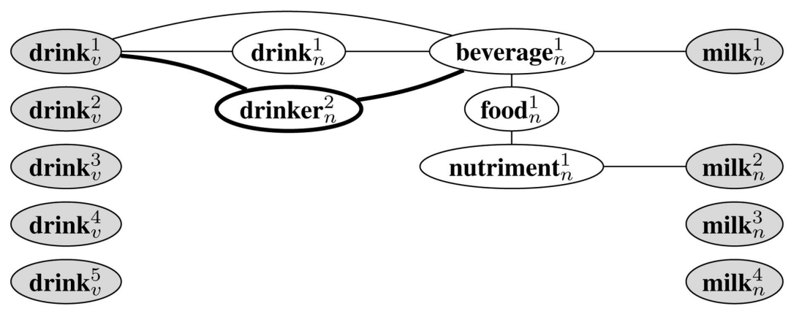
Method — Constructing the Graph
“She drank some milk”
“drink” (5 senses)
“milk” (4 senses)

Slide 36
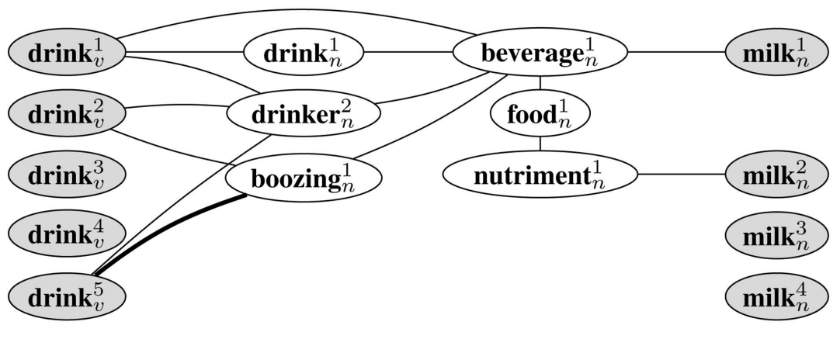
Method — Constructing the Graph
“She drank some milk”
“drink” (5 senses)
“milk” (4 senses)

Slide 37
Method — Choosing Senses (Local measures)
Compute centrality of each node in our sentence graph
Degree
PageRank
HITS
Key Player Problem
Betweenness
Pick the most “central” sense for each word
Notes:
I’m going to very quickly run thru all the different centrality methods
Compute centrality of each node in our sentence graph
Degree
PageRank
HITS
Key Player Problem
Betweenness
Pick the most “central” sense for each word

Slide 38
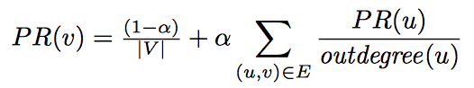
Local Connectivity — PageRank
Node centrality is defined recursively in terms of centralities of neighbors
Important if strongly connected to important nodes
Unimportant if weakly connected to unimportant nodes
There’s a weighted version
Solve by simulating a random walk
Notes:
Solution is the stable distribution of a random walk
\alpha is the random surfer model: ensures that this converges / everything mixes you can’t be important just because the walk gets stuck at you
Node centrality is defined recursively in terms of centralities of neighbors
Important if strongly connected to important nodes
Unimportant if weakly connected to unimportant nodes
There’s a weighted version
Solve by simulating a random walk

Slide 39
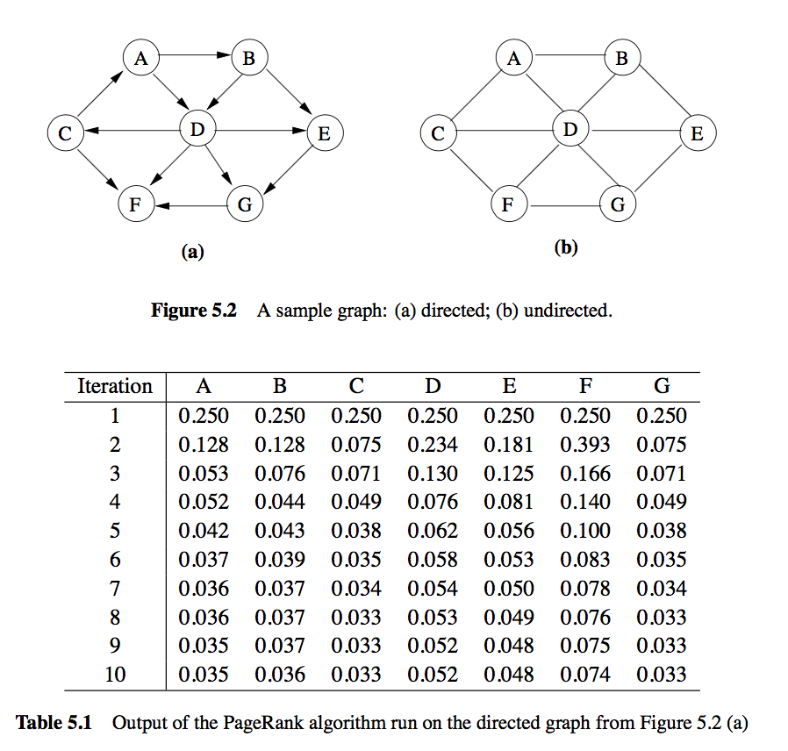
Local Connectivity — PageRank
https://dl.acm.org/citation.cfm?id=1984806
Notes:
After one step, we’re much more likely to be at node F than node C
Keep going until converges

Slide 40
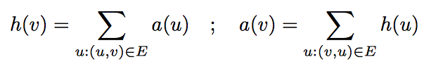
Local Connectivity — HITS
Like PageRank, but separate authoritativeness and hubness scores (also defined recursively)
Solve by initializing all scores to 1, then repeatedly updating and normalizing until you reach steady-state
Notes:
There are two ways a node can be important
Authoritative: lots of good hubs link to it (you’re a good source)
Hubs: it links to lots of good authorities
Like PageRank, but separate authoritativeness and hubness scores (also defined recursively)
Solve by initializing all scores to 1, then repeatedly updating and normalizing until you reach steady-state

Slide 41
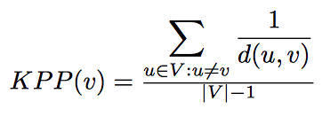
Local Connectivity — Key Player Problem (KPP)
Average “closeness” to the other nodes
“Closeness” is reciprocal of geodesic distance d(u,v)
Notes:
Average “closeness” to the other nodes
“Closeness” is reciprocal of geodesic distance d(u,v)

Slide 42
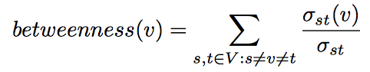
Local Connectivity — Betweenness
A node is important if it’s part of many shortest paths
It’s “between” many pairs of vertices
Divide this by number of pairs of vertices to normalize
Notes:
Sigma_st is num of shortest paths from s to t (there could be more than one of equal length)
sigma_st(v) is num of those that pass thru v
A node is important if it’s part of many shortest paths
It’s “between” many pairs of vertices
Divide this by number of pairs of vertices to normalize

Slide 43
Method — Choosing Senses (Global measures)
For each combination of sense choices, make an “interpretation” subgraph by dropping all unused senses
Calculate the “connectedness” of the interpretation
Compactness
Graph Entropy
Edge density
Pick the most connected interpretation
Notes:
Skip these
For each combination of sense choices, make an “interpretation” subgraph by dropping all unused senses
Calculate the “connectedness” of the interpretation
Compactness
Graph Entropy
Edge density
Pick the most connected interpretation

Slide 44
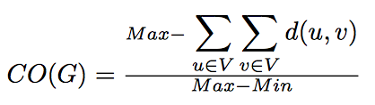
Global Connectivity — Compactness
Sum of all pairwise distances in the graph tells you how “compact” it is
Maximum: all n(n-1) paths have length n: max = n²(n-1)
Minimum: all n(n-1) paths have length 1: min = n(n-1)
Find how compact graph is on a scale from min to max:
Notes:
SKIP
If two nodes are not connected, let their distance be n
Sum of all pairwise distances in the graph tells you how “compact” it is
Maximum: all n(n-1) paths have length n: max = n²(n-1)
Minimum: all n(n-1) paths have length 1: min = n(n-1)
Find how compact graph is on a scale from min to max:

Slide 45
Global Connectivity — Entropy
Associate “probability” of each vertex by proportion of edges it’s connected to
High “entropy” of this distribution: all vertices are equal
Low “entropy” a few very important vertices (with lots of the probability mass)
Notes:
Associate “probability” of each vertex by proportion of edges it’s connected to
High “entropy” of this distribution: all vertices are equal
Low “entropy” a few very important vertices (with lots of the probability mass)

Slide 46
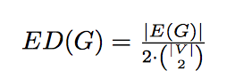
Global Connectivity — Edge Density
How many of the possible edges are present?
Notes:
Need the 2 b/c directed edges

Slide 47
Experiment
Picking a random sense provides a lower bound method
Picking the most frequent sense is an upper bound method
(remember, goal is to do unsupervised WSD so this would be cheating)
For lexicon, use WordNet and Enriched WordNet
Adds 60K “semantic relatedness” edges
Notes:
Picking a random sense provides a lower bound method
Picking the most frequent sense is an upper bound method
(remember, goal is to do unsupervised WSD so this would be cheating)
For lexicon, use WordNet and Enriched WordNet
Adds 60K “semantic relatedness” edges

Slide 48
Runtime
For global measures, there are too many combinations of senses to actually try them all
Simulated Annealing (perturb sense choices one at a time)
Genetic Algorithms (mix two good choices to make a better one)
Notes:
For global measures, there are too many combinations of senses to actually try them all
Simulated Annealing (perturb sense choices one at a time)
Genetic Algorithms (mix two good choices to make a better one)

Slide 49
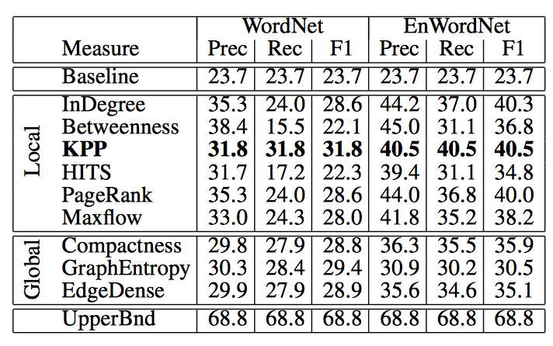
Results
Betweenness and PageRank have good precision
KPP has best recall and F1
Global measures are a bit worse
They all do better trained on EnrichedWordNet, but especially local measures
hard for global measures to sample all those edges
Notes:
All do better than baseline and worse than upper bound
Betweenness and PageRank have good precision
KPP has best recall and F1
Global measures are a bit worse
They all do better trained on EnrichedWordNet, but especially local measures
hard for global measures to sample all those edges

Slide 50
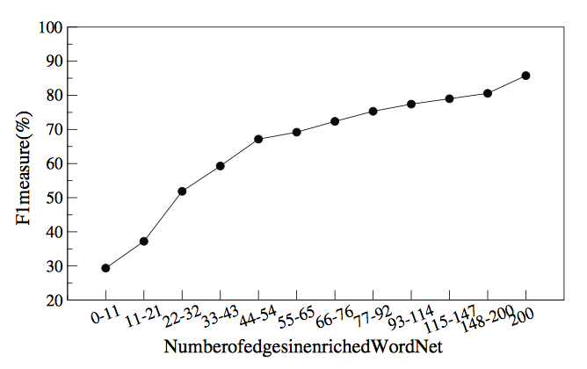
Results
KPP is better (higher F1) on words with more edges in the word graph
Makes a huge difference (like having more training data)
Method easily ports to new languages/domains
Can add combine this with supervised method to improve them
Notes:
KPP is better (higher F1) on words with more edges in the word graph
Makes a huge difference (like having more training data)
Method easily ports to new languages/domains
Can add combine this with supervised method to improve them

Slide 51
Multi-Sentence Compression:
Finding Shortest Paths in Word Graphs
Katja Filippova
COLING 2010
Notes:
Uses a word network to produce summaries

Slide 52
Problem
Given a cluster of related sentences, produce a short summary sentence
Summary should capture meaning of the cluster
Summary should be grammatical
Application: summarize a news event given sentences from different articles
Can we make this lightweight?
only a POS tagger — no language model, no parameters to train
(use redundancy to encourage grammatical summaries instead)
Notes:
Including many redundant (grammatical) sentences will make summary grammatical
Given a cluster of related sentences, produce a short summary sentence
Summary should capture meaning of the cluster
Summary should be grammatical
Application: summarize a news event given sentences from different articles
Can we make this lightweight?
only a POS tagger — no language model, no parameters to train
(use redundancy to encourage grammatical summaries instead)

Slide 53
Method — Word Graph
Each vertex is a word (or <s>, </s>)
Directed edges join words if they’re adjacent in a sentence
For each sentence:
Add new vertex for words in this sentence that already have one (for this POS) or extras if words appear twice
Add directed edge between adjacent words (incl. <s> </s>)
Weight > 1 if adjacency appears more than once
Notes:
Each vertex is a word (or <s>, </s>)
Directed edges join words if they’re adjacent in a sentence
For each sentence:
Add new vertex for words in this sentence that already have one (for this POS) or extras if words appear twice
Add directed edge between adjacent words (incl. <s> </s>)
Weight > 1 if adjacency appears more than once

Slide 54
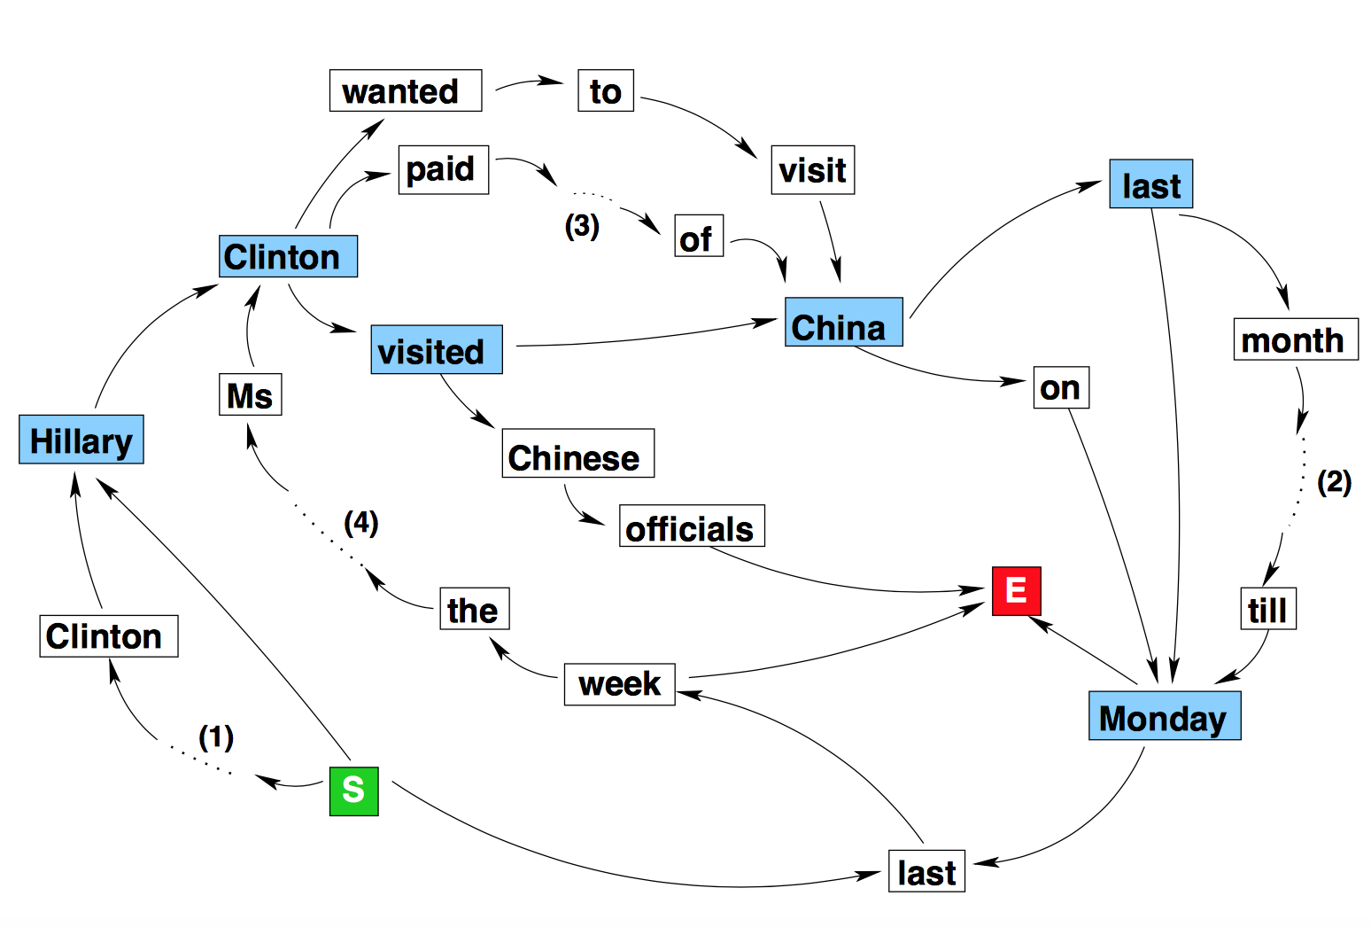
Method — Word Graph
The wife of former U.S. president Bill Clinton, Hillary Clinton, visited China last Monday
Hillary Clinton wanted to visit China last month but postponed her plans till Monday last week.
Hillary Clinton paid a visit to the People’s Republic of China on Monday
Last week the Secretary of State Ms. Clinton visited Chinese officials
Notes:
You can see “Clinton” appears twice because it appears twice in the first sentence
If you were wondering how old this paper is, it’s old enough that Hillary is still “Bill’s wife”

Slide 55
Method — Shortest Path
Looking for a summary that
Is not too long or short
Hits important concepts
Is a likely word sequence (grammatical or close to it)
Find shortest path from <s> to </s>
Take reciprocal of edge weights (encourages following common edges)
At least 8 words long
Contains a verb (encourages informative sentence—capture main action)
Notes:
Looking for a summary that
Is not too long or short
Hits important concepts
Is a likely word sequence (grammatical or close to it)
Find shortest path from <s> to </s>
Take reciprocal of edge weights (encourages following common edges)
At least 8 words long
Contains a verb (encourages informative sentence—capture main action)

Slide 56
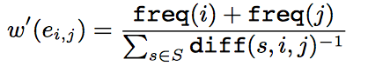
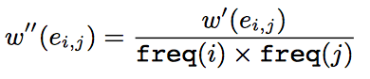
Model — Shortest Path++
Further encourage grammatical and salient compression
Give ½ weight to pair of words that are 2 apart, ⅓ weight to words that are 3 apart, etc.
Scale edge weight to account for frequency of the words it connects
Words should be strongly associated with each other and be salient (high frequency)
Find shortest path relative to length (divide by length)
Notes:
Add some extra edges: “give ½ weight”
Further encourage grammatical and salient compression
Give ½ weight to pair of words that are 2 apart, ⅓ weight to words that are 3 apart, etc.
Scale edge weight to account for frequency of the words it connects
Words should be strongly associated with each other and be salient (high frequency)
Find shortest path relative to length (divide by length)

Slide 57
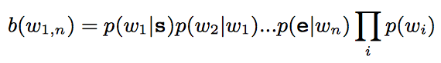
Experiment
Use clusters from Google News in English and Spanish
24 articles per cluster on average
Take first sentence of each — we need similar sentences that capture the topic well
Baseline: use Viterbi to find most likely sequence on eight tokens, weighted by the frequency of the words (frequent words are more salient)
Evaluated using human raters: rated out of three on informativity and grammaticality
Notes:
Use clusters from Google News in English and Spanish
24 articles per cluster on average
Take first sentence of each — we need similar sentences that capture the topic well
Baseline: use Viterbi to find most likely sequence on eight tokens, weighted by the frequency of the words (frequent words are more salient)
Evaluated using human raters: rated out of three on informativity and grammaticality

Slide 58
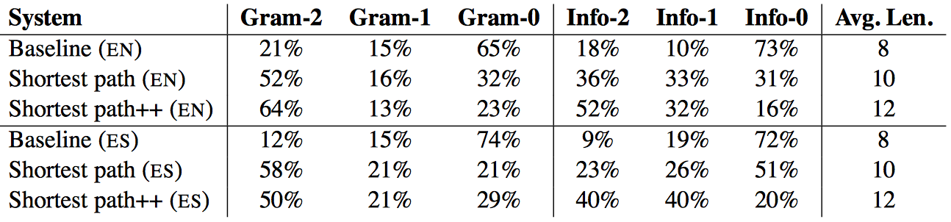
Results
Spanish had fewer stopwords — maybe dragged down performance
Both compress significantly (~40%), more aggressive than other systems
Pretty good for being syntax-blind! Could work for low resource langs
Notes:
Spanish had fewer stopwords — maybe dragged down performance
Both compress significantly (~40%), more aggressive than other systems
Pretty good for being syntax-blind! Could work for low resource langs

Slide 59
Neural Methods

Slide 60
Graph-based Neural Multi-document Summarization
Michihiro Yasunaga, Rui Zhang, Kshitijh Meelu, Ayush Pareek, Krishnan Srinivasan, Dragomir Radev
CoNLL 2017
Notes:
Drago was on this paper—I’m sure someone else in the room worked on it, please interrupt and correct me
Main idea with these graph methods is: there’s structure in these graphs (they’re not random). Let the neural network learn to capture it in the vector embeddings

Slide 61
Problem: Multi-document Summarization (MDS)
Traditional methods: select sentences using graph methods
Graphs encode sentence relationships
Neural methods: strong representational power
Struggle to capture relationships between sentences
Need too much training data for multidoc tasks
This paper: neural representations AND graphs to encode relationships
Notes:
Neural methods = for single document summarization
This method has a lot of parts but each of them is straightforward
Traditional methods: select sentences using graph methods
Graphs encode sentence relationships
Neural methods: strong representational power
Struggle to capture relationships between sentences
Need too much training data for multidoc tasks
This paper: neural representations AND graphs to encode relationships

Slide 62
Method — Constructing the graph
Edge weight is tf-idf cosine similarity
threshold > 0.2
Approximate Discourse Graph (Christensen et al 2013)
Uses discourse relation features
Edges weights are ≈ multiples of 0.5
Personalized Discourse Graph (new!)
Start with ADG
Reweigh directed edges based on linear combo of features about source sentence
Notes:
Each vertex is a sentence from one of the documents
TF_IDF vector has one entry per word in the vocabulary
ADG: “The ADG constructs edges between sentences by counting dis- course relation indicators such as deverbal noun references, event / entity continuations, discourse markers, and co-referent mentions. These features allow characterization of sentence relationships, rather than simply their similarity.”
Discourse relation features
Personalization features:
• Position in Document • From 1st 3 Sentences? • No. of Proper Nouns • > 20 Tokens in Sentence? • Sentence Length • No. of Co-referent Verb Mentions • No. of Co-referent Common Noun Mentions • No. of Co-referent Proper Noun Mentions
Edge weight is tf-idf cosine similarity
threshold > 0.2
Approximate Discourse Graph (Christensen et al 2013)
Uses discourse relation features
Edges weights are ≈ multiples of 0.5
Personalized Discourse Graph (new!)
Start with ADG
Reweigh directed edges based on linear combo of features about source sentence

Slide 63
Method — Input Features
Run a GRU along word embeddings (word2vec) in each sentence
Last hidden state is the sentence embedding
Map it to the node for that sentence: call matrix of embeddings X
Cluster (multi-doc) Embedding:
Run another GRU along the sentence embeddings in each document
Last hidden state is the document embedding
Take mean of document embeddings to get the corpus embedding
Notes:
One cluster embedding for the whole cluster: save it for later
Run a GRU along word embeddings (word2vec) in each sentence
Last hidden state is the sentence embedding
Map it to the node for that sentence: call matrix of embeddings X
Cluster (multi-doc) Embedding:
Run another GRU along the sentence embeddings in each document
Last hidden state is the document embedding
Take mean of document embeddings to get the corpus embedding

Slide 64
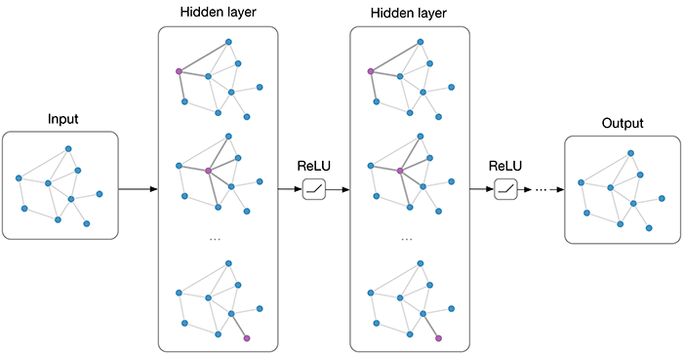
Method — Graph Convolutional Network (GCN)
https://tkipf.github.io/graph-convolutional-networks/
Notes:
Introduced by Kipf and Welling
They used it for classification
This paper uses it to score salience of sentences
Tried to find a good image to explain GCNs, this is the best I got

Slide 65
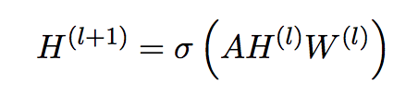
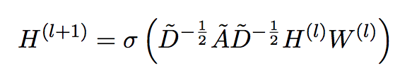
Method — Graph Convolutional Network (GCN)
Kipf and Welling, “Semi-Supervised Classification with Graph Convolutional Networks” ICLR 2017
Let H⁽⁰⁾ = X
Sum embeddings of all neighbors of vertex v, then apply linear combination and non-linearity to get next layer:
Normalize to correct for different degrees, add self loops:
Top layer Z = H^{(L)} gives graph-aware sentence embeddings
Notes:
...then we repeat: at each layer, aggregated embeddings from neighbors in previous layer
Introduced by Kipf and Welling
They used it for classification
This paper uses it to score salience of sentences
We started off with sentence embeddings — now we have new sentence embeddings enriched by the related sentences
Kipf and Welling, “Semi-Supervised Classification with Graph Convolutional Networks” ICLR 2017
Let H⁽⁰⁾ = X
Sum embeddings of all neighbors of vertex v, then apply linear combination and non-linearity to get next layer:
Normalize to correct for different degrees, add self loops:
Top layer Z = H^{(L)} gives graph-aware sentence embeddings

Slide 66
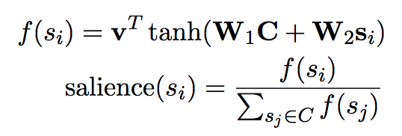
Method — Salience Estimation
Combine sentence embedding with cluster embedding
Normalize
Notes:
W_1 W_2 and v are all learned parameters
C is the cluster embedding (a vector)
Combine sentence embedding with cluster embedding
Normalize

Slide 67
Method — Training
Minimize the cross entropy between salience of a sentence and normalized ROUGE score of the sentence
ROUGE measures how much of the target summary was reproduced
They use mean of
ROUGE-1: how many words are shared with human-written reference summaries?
ROUGE-2: how many bigrams are shared with reference summaries?
Reference: “The cat was still up there”
Candidate: “A cat was up there”
ROUGE-2 = #(cat was, up there) / #(the cat, cat was, was still, still up, up there)
= 2 / 5
Notes:
All that gives us salience estimations
What is our objective?
Minimize the cross entropy between salience of a sentence and normalized ROUGE score of the sentence
ROUGE measures how much of the target summary was reproduced
They use mean of
ROUGE-1: how many words are shared with human-written reference summaries?
ROUGE-2: how many bigrams are shared with reference summaries?
Reference: “The cat was still up there”
Candidate: “A cat was up there”
ROUGE-2 = #(cat was, up there) / #(the cat, cat was, was still, still up, up there)
= 2 / 5

Slide 68
Method — Sentence Selection
Sort sentences by salience
Greedily pick the next most salient sentence that isn’t redundant
Redundant if tf-idf cosine similarity > 0.5
Notes:
Now to actually produce the summary
Sort sentences by salience
Greedily pick the next most salient sentence that isn’t redundant
Redundant if tf-idf cosine similarity > 0.5

Slide 69
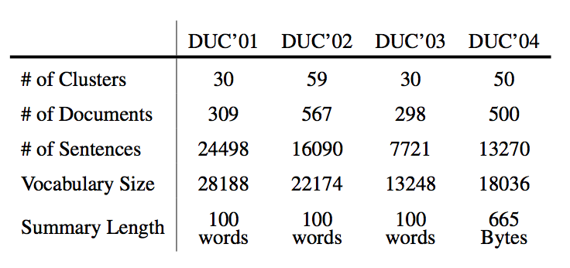
Experiments — Datasets
Used Document Understanding Conferences (DUC) 2001-2004
Clusters of about 10 related news articles
Each cluster comes has a human written summary
Train on 2001-2, validate on 2003, test on 2004 dataset
Notes:
Introduced by Kipf and Welling
Used Document Understanding Conferences (DUC) 2001-2004
Clusters of about 10 related news articles
Each cluster comes has a human written summary
Train on 2001-2, validate on 2003, test on 2004 dataset

Slide 70
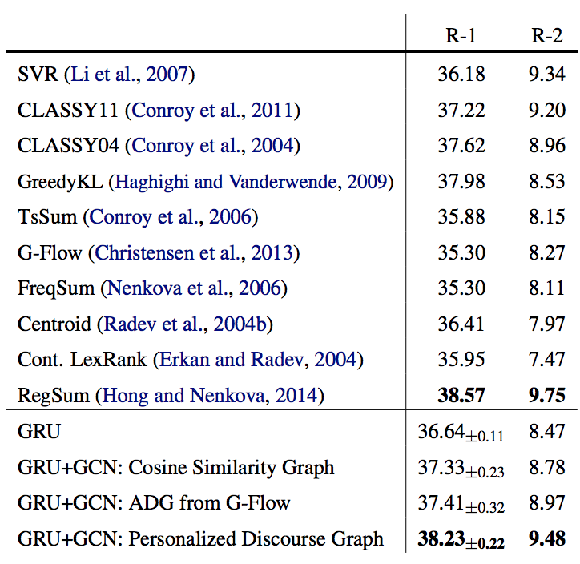
Experiments
Compared three types of graph (cosine similarity, approximate discourse graph, personalized discourse graph)
Evaluated Rouge-1 and -2
Discourse Graph does best
Notes:
Top is baseline methods
Bottom is their method: 3 kinds of graph construction + control where they don’t run GCN at all (just use sentence embeddings
Compared three types of graph (cosine similarity, approximate discourse graph, personalized discourse graph)
Evaluated Rouge-1 and -2
Discourse Graph does best

Slide 71
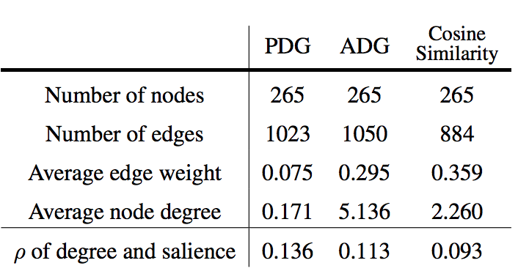
Graph Topology
Better correlation => better method
Notes:
Compared the salience scores to the degree of the node/sentence
Rho is correlation
Better correlation => better method

Slide 72
Inductive Representation Learning on Large Graphs
William Hamilton, Rex Ying, Jure Leskovec
Notes:
Required paper
Another way of producing graph embeddings (not GCN)

Slide 73
Background: Deepwalk
DeepWalk introduced by Perozzi, Al-Rfou, and Skiena in 2014
Unsupervised method for learning representation of vertices in a graph
Same intuition as word2vec: vertices that appear in similar contexts should have related representation
Instead of modeling sentences, model random walks
Generate a “corpus” of random walks on the graph starting from each node
Treat these as sentences in word2vec: use the embedding to predict which other nodes are in the random walk
Adjust the embeddings using SGD to improve the prediction
Notes:
Unsupervised UNLIKE GCNs
In word2vec we are given a corpus of sentences: here we MAKE a corpus of random walks
DeepWalk introduced by Perozzi, Al-Rfou, and Skiena in 2014
Unsupervised method for learning representation of vertices in a graph
Same intuition as word2vec: vertices that appear in similar contexts should have related representation
Instead of modeling sentences, model random walks
Generate a “corpus” of random walks on the graph starting from each node
Treat these as sentences in word2vec: use the embedding to predict which other nodes are in the random walk
Adjust the embeddings using SGD to improve the prediction

Slide 74
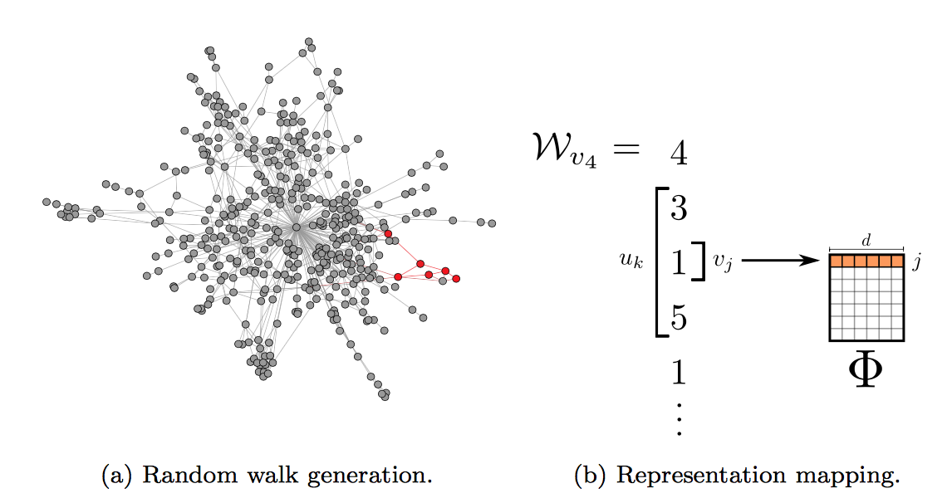
https://arxiv.org/abs/1403.6652
Notes:
The walk starts at 4 => 3 => 1 => 5

Slide 75
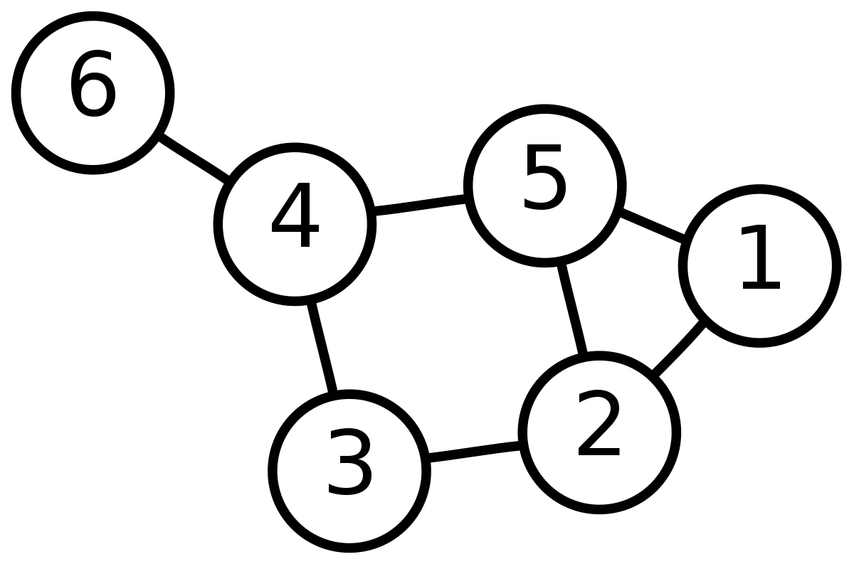
1 2 5
1 5 4
1 2 3
6 4 3
6 4 5
3 2 3 ...
2 co-occurs with: 1, 1, 3, 3, 3, 5, ...
https://arxiv.org/abs/1403.6652

Slide 76
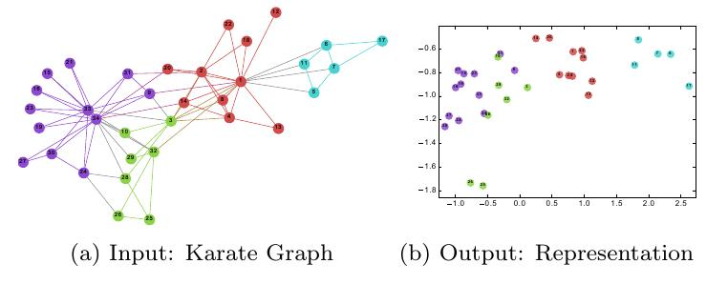
https://arxiv.org/abs/1403.6652

Slide 77
Problem
Produce low-dimensional vector embeddings of nodes in graphs
Many algorithms (matrix factorization, DeepWalk) are transductive
They have to be retrained on new nodes
For word embeddings, this isn’t a problem because vocabulary is pretty stable, but in graph tasks we can’t reuse graphs
DeepWalk can’t handle node features
GCN used in previous paper requires supervised training, and loses information by averaging representations of all the neighbors in the convolution step
GraphSage generalizes GCN to better capture relationships with neighbors
Notes:
Produce low-dimensional vector embeddings of nodes in graphs
Many algorithms (matrix factorization, DeepWalk) are transductive
They have to be retrained on new nodes
For word embeddings, this isn’t a problem because vocabulary is pretty stable, but in graph tasks we can’t reuse graphs
DeepWalk can’t handle node features
GCN used in previous paper requires supervised training, and loses information by averaging representations of all the neighbors in the convolution step
GraphSage generalizes GCN to better capture relationships with neighbors

Slide 78
Method — Generating Embeddings
Start with a feature vector for each vertex at layer 0
Sample fixed number of neighbors from the neighborhood (the number varies by layer)
Aggregate the embeddings from the previous layer using
Mean (same as GCN)
LSTM (affected by permutation of the neighbors but expressive)
Max pooling: feed each neighbor’s embedding thru a fully connected layer THEN pool
(could also use mean here but max worked better)
Concatenate this vertex’s last embedding with aggregate of neighbors and pass to feed-forward layer
Normalize
Notes:
Sampling fixed number (even if it’s very large) could help generalize when new nodes are added on
Start with a feature vector for each vertex at layer 0
Sample fixed number of neighbors from the neighborhood (the number varies by layer)
Aggregate the embeddings from the previous layer using
Mean (same as GCN)
LSTM (affected by permutation of the neighbors but expressive)
Max pooling: feed each neighbor’s embedding thru a fully connected layer THEN pool
(could also use mean here but max worked better)
Concatenate this vertex’s last embedding with aggregate of neighbors and pass to feed-forward layer
Normalize

Slide 79
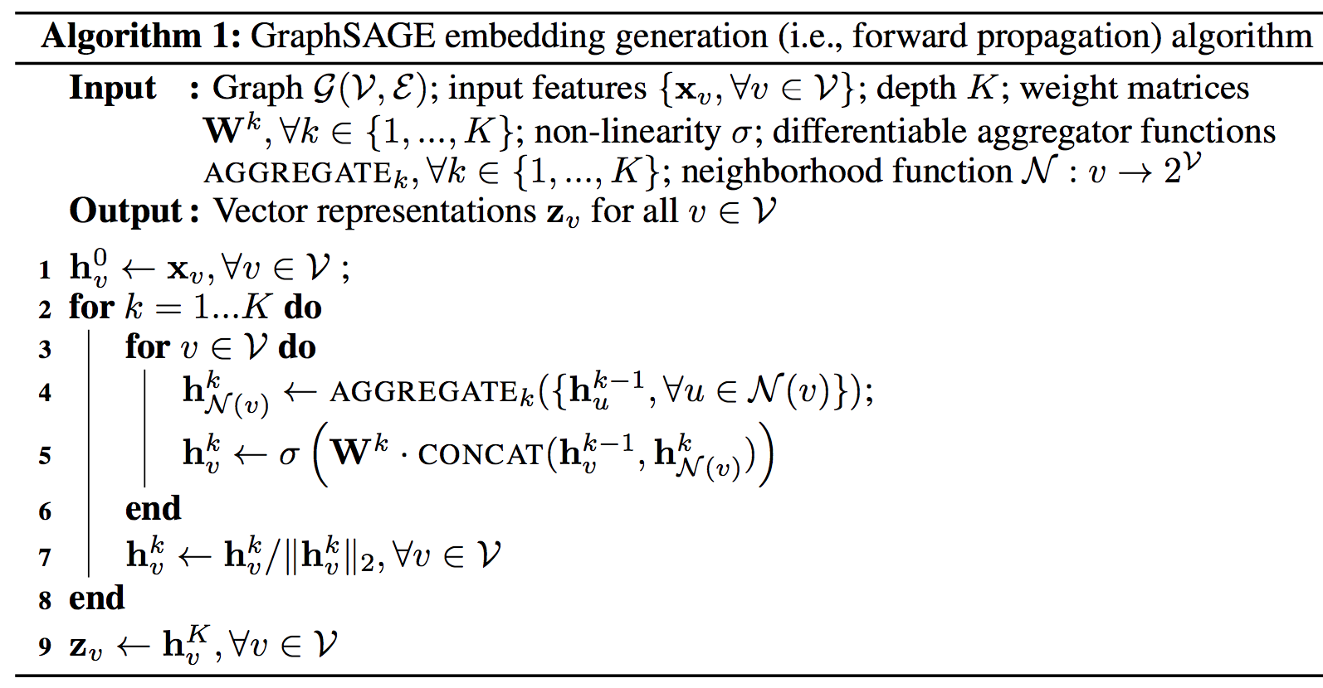
Method — Generating Embeddings
Notes:
pseudo-code

Slide 80
Method — Unsupervised Training
We want nodes that are nearby to have similar embeddings (cosine similarity)
Nodes that are far away should have dissimilar embeddings
Use negative sampling: Pn(v) is random (probably far away) node
These embeddings should generalize to any task
Can add supervised or semi-supervised loss if we know what we need them for
For node u, sample nearby nodes v using 50 random walks of length 5
Notes:
Takes inspiration from DeepWalk
Zs are unit vectors: but product of two can still be negative, so need sigmoid
We want nodes that are nearby to have similar embeddings (cosine similarity)
Nodes that are far away should have dissimilar embeddings
Use negative sampling: Pn(v) is random (probably far away) node
These embeddings should generalize to any task
Can add supervised or semi-supervised loss if we know what we need them for
For node u, sample nearby nodes v using 50 random walks of length 5

Slide 81
Experiments — Classification
Citation Network: classify papers into one of 6 biology subfields
300K nodes (avg. degree 9.15) from Thomson Reuters Web of Science
Features: simple sentence embeddings of the abstract
Undirected edge if one paper cites the other
Train: 2000-2004, test on 2005
Reddit: classify posts into one of 50 subreddits
230K nodes (avg. degree 492)
Features: avg GloVe embedding of title, avg embedding of comments, num comments, post score
Edge if the same user commented on both posts
Train on 20 days, test on next 11 days (September 2014)
Notes:
The classification is trained on part of the graph, has to generalize to new nodes
Citation Network: classify papers into one of 6 biology subfields
300K nodes (avg. degree 9.15) from Thomson Reuters Web of Science
Features: simple sentence embeddings of the abstract
Undirected edge if one paper cites the other
Train: 2000-2004, test on 2005
Reddit: classify posts into one of 50 subreddits
230K nodes (avg. degree 492)
Features: avg GloVe embedding of title, avg embedding of comments, num comments, post score
Edge if the same user commented on both posts
Train on 20 days, test on next 11 days (September 2014)

Slide 82
Experiments — Classification
In those examples, had to generalize to new nodes
What about completely new graphs?
Protein-protein Interaction network
Each graph is a human tissue (20 train, 2 validation, 2 test)
Each node is a protein (avg 2373 nodes, degree 28.8)
Features are “positional gene sets, motif gene sets and immunological signatures”
Classify into one of 121 “gene ontology sets”
Notes:
The learned parameters should transfer to new graph in a similar domain
In those examples, had to generalize to new nodes
What about completely new graphs?
Protein-protein Interaction network
Each graph is a human tissue (20 train, 2 validation, 2 test)
Each node is a protein (avg 2373 nodes, degree 28.8)
Features are “positional gene sets, motif gene sets and immunological signatures”
Classify into one of 121 “gene ontology sets”

Slide 83
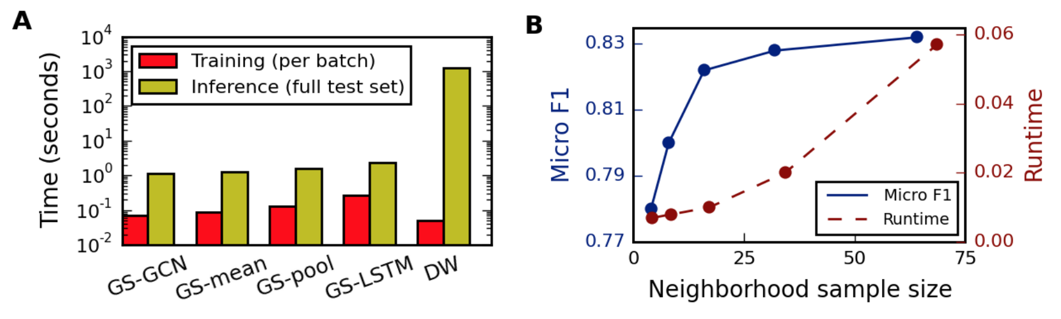
Experiments — Runtime
More than K=2 graph layers doesn’t improve much
Diminishing returns for large neighborhoods: sampling doesn’t hurt much
Orders of magnitude faster than DeepWalk to produce new embedding
Notes:
You only need 2 layers, you only need to sample a few vertices
DW is deepwalk
More than K=2 graph layers doesn’t improve much
Diminishing returns for large neighborhoods: sampling doesn’t hurt much
Orders of magnitude faster than DeepWalk to produce new embedding

Slide 84
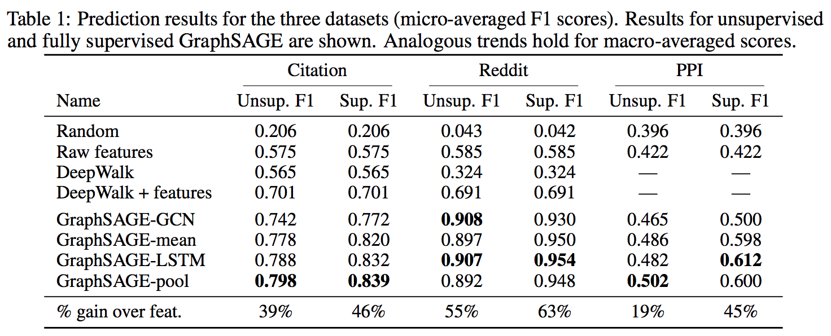
Results
Notes:
Does much better than deepwalk
Does a few points better than vanilla GCN
Does MUCH better on the PPI task
Deepwalk+features: concatenate deepwalk embeddings with your features
GCN totally outperforms baseline
Trainable aggregators (LSTM and max pooling) outperform GCN
(Wilcoxon signed rank test, p= .02)
Unsupervised is nearly as good as supervised training

Slide 85
Results
GCN totally outperforms baseline
Trainable aggregators (LSTM and max pooling) outperform GCN
(Wilcoxon signed rank test, p= .02)
Unsupervised is nearly as good as supervised training
Notes:
GCN totally outperforms baseline
Trainable aggregators (LSTM and max pooling) outperform GCN
(Wilcoxon signed rank test, p= .02)
Unsupervised is nearly as good as supervised training

Slide 86
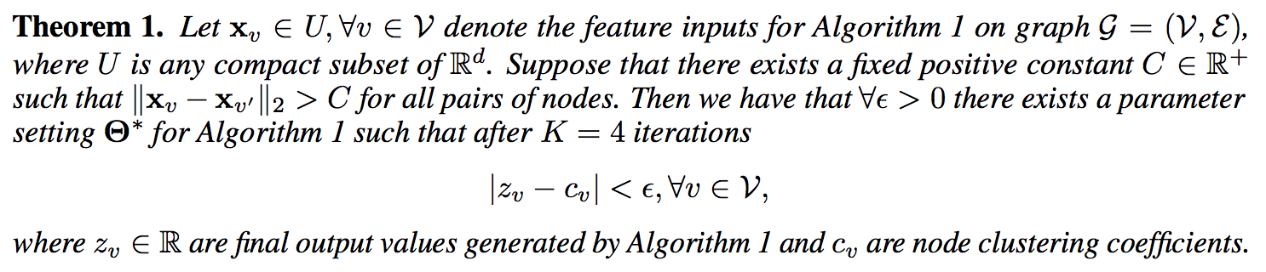
Proof: Can capture graph properties
GraphSage can learn to compute local clustering coefficient

Slide 87
Summary
Navigli and Lapata applied graph centrality methods to subgraphs of WordNet to do Word Sense Disambiguation
Filippova used shortest paths in a weighted word graph for summarizing similar sentences
LILY used graph convolutional networks for multi-document summarization
Hamilton et al introduce GraphSage, an unsupervised, more general extension of Graph Convolutional Networks
Notes:
Navigli and Lapata applied graph centrality methods to subgraphs of WordNet to do Word Sense Disambiguation
Filippova used shortest paths in a weighted word graph for summarizing similar sentences
LILY used graph convolutional networks for multi-document summarization
Hamilton et al introduces GraphSage, an unsupervised, more general extension of Graph Convolutional Networks

Slide 88
Discussion questions 1/2
NLP made huge progress when we stopped thinking of words as discrete and started thinking of them as points in R^n. How can we integrate “discrete” methods of traditional graph theory with “continuous” neural methods (think vector embeddings and GCNs)?
What other kinds of tasks can be framed as problems of learning on graphs?
LILY’s summarization paper picks sentences greedily if they’re not too similar to the summary so far. Is there a way to use the graph structure to help us with sentence selection too?
Notes:
We made huge progress as a field when we stopped thinking of words as discrete items in a dictionary and started thinking of them as points in R^n. People related GCNs and other models to approximations of spectral learning, e.g. -- so at least it’s inspiration
Classes of problem: visualization, community detection, classifying nodes, link prediction

Slide 89
Discussion questions 2/2
DeepWalk cleverly repurposed the Skipgram model for a new domain. Can you think of other areas where this idea could be recycled?
The representation methods we looked at capture community structure. Can you think of a time where it might be useful to embed structural role instead? How would you go about this?
We saw DeepWalk, GCNs, and GraphSage: can you think of any other variations of graph representation methods?
Notes:
We made huge progress as a field when we stopped thinking of words as discrete items in a dictionary and started thinking of them as points in R^n. People related GCNs and other models to approximations of spectral learning, e.g. -- so at least it’s inspiration
Classes of problem: visualization, community detection, classifying nodes, link prediction

Slide 90
Network Methods for NLP
Noah Amsel
11/6/18

